Slide 1
Generative Adversarial Networks
(GANs)
Seminar Presentation
Guided by:
Dr. Deepa V.
Presented by:
Ajay T Shaju (SJC20AD004)
Artificial Intelligence & Data Science Seminar: ADQ413 5th October 2023 1/33
Notes:
It was a rainy day, and there exist a young and talented photographer who sits inside a car with sigh, he got some nice frames to capture, but due to the rain he is not able to take the stills. Somehow he managed to some pictures of some landscapes and all, and he got a result like this (next slide)

Slide 2
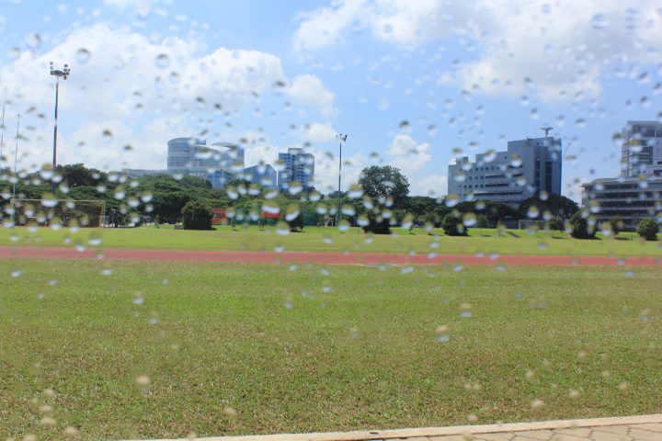
THE STORY
Young Photographer captured photos in a rainy day, and he got this:
Artificial Intelligence & Data Science Seminar: ADQ413 5th October 2023 2/33
Notes:
He was so disappointed with the result so he searched on the internet to remove the mist and rain from the images, without touching the main subject and he found the amazing technology GANs, so he made a learning path and we are going to explore it (next slide)

Slide 3
OUTLINE
Introduction
Discriminative and Generative models
Details of Generative Adversarial Networks
Components – Generator & Discriminator
Architecture
Loss Function
Training
Challenges of GANs – Mode Collapse & Non-Convergence
Types of GANs
Uses of GANs
Recent Application of GAN
FIGAN: CNN Learned Features
Artificial Intelligence & Data Science Seminar: ADQ413 5th October 2023 3/33
Notes:
His learning path is our seminar’s outline, so lets explore…

Slide 4
INTRODUCTION
Machine Learning Models
Discriminative Models Generative Models
Discriminative Models – Separates the data points into different classes.
Mostly Supervised in nature.
Eg – Logistic Regression.
Generative Models – Models that can generate new data points within its training data.
Mostly Un-Supervised in nature.
Eg – GANs.
Artificial Intelligence & Data Science Seminar: ADQ413 5th October 2023 4/33
Notes:
First of all, we need to understand that, ML models are classified into gen and dis

Slide 5
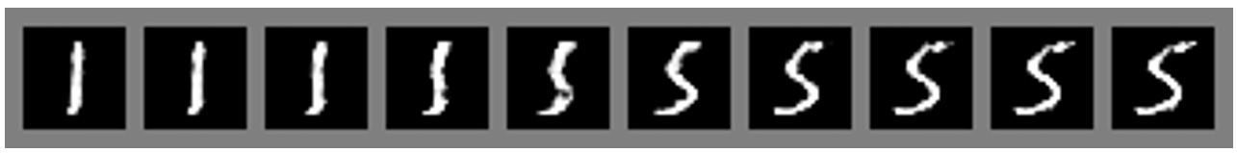
Generative Adversarial Networks
Introduced by Ian J Goodfellow in June 2014. Generative Adversarial Networks (GANs) is a type of deep learning model that are used to generate new data that is similar to the data it was trained on.
As per the creator, GAN is a framework for estimating generative models via an adversarial process. [1]
GAN is a type of unsupervised machine learning.
Smooth transition from 1 to 5 (Image source: NIPS GAN Paper [2])
Artificial Intelligence & Data Science Seminar: ADQ413 5th October 2023 5/33
Notes:
Game Theory - Zero Sum Game

Slide 6
GAN COMPONENTS – GENERATOR & DISCRIMINATOR
GAN composed of two neural networks
Generator Discriminator
Responsible for creating new data (i.e fake data)
Responsible for distinguishing between real and fake data.
GANs were inspired by the game theory, the generator and discriminator will compete each other to achieve the Nash equilibrium(i.e achieving the desired outcome not by deviating from initial strategy) during its training process. [2]
Artificial Intelligence & Data Science Seminar: ADQ413 5th October 2023 6/33

Slide 7
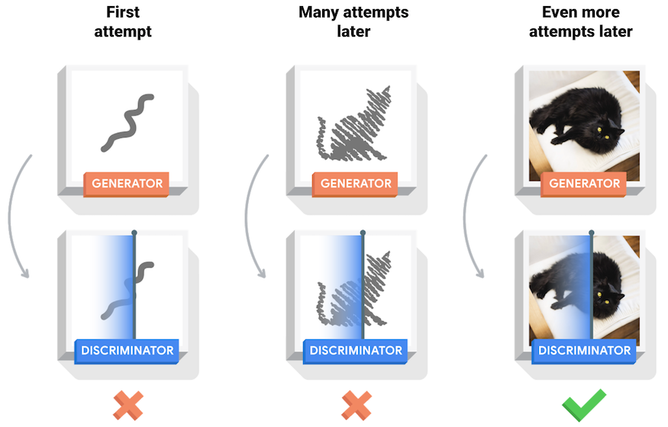
Working of Generator And Discriminator
Image source: TensorFlow
Artificial Intelligence & Data Science Seminar: ADQ413 5th October 2023 7/33
Notes:
From this image, we could explain game theory behind gans, Game theory → zero sum game, if discriminator is correct, it will get +1 and gen will get -1 so net amount is 0

Slide 8
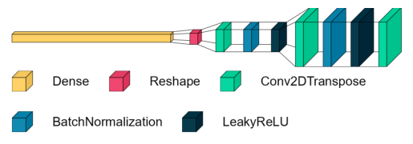
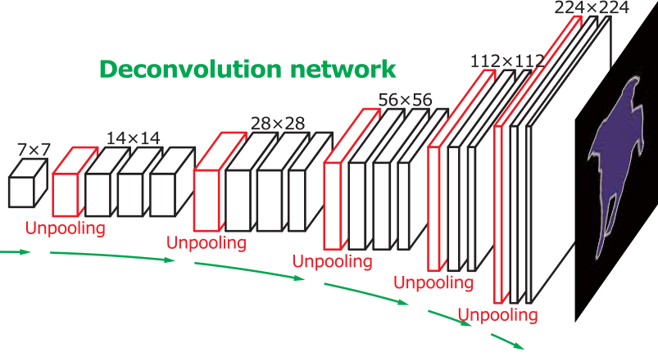
GENERATOR
The Generator is a Deconvolution and Unpooling Layered Network (Image Generation).
Noise
Fake Image
Simple Generator Architecture.
(Image source: Author)
Deconvolution Network
(Image source: Open Genus)
Artificial Intelligence & Data Science Seminar: ADQ413 5th October 2023 8/33
Notes:
Deconvolution, upsampling and unpooling layers, just like a variational autoencoder.

Slide 9
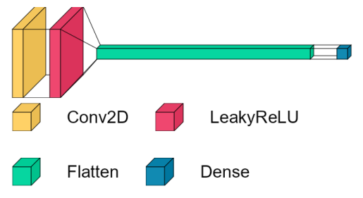
DISCRIMINATOR
The discriminator is just a normal binary classifier(CNN).
Real Image
Real / Fake
1 / 0
Fake Image
Simple Discriminator Architecture. (Image source: Author)
Artificial Intelligence & Data Science Seminar: ADQ413 5th October 2023 9/33
Notes:
Draw → gen and disc on board…with fake and clasificiation task involved too…

Slide 10
GAN ARCHITECTURE
Artificial Intelligence & Data Science Seminar: ADQ413 5th October 2023 10/33
Notes:
Random vector or set of values that is fed as input to the GAN's generator network
For creating a realistic image using GAN the noise will be some random numbers which represents a characteristic of the generated image

Slide 11
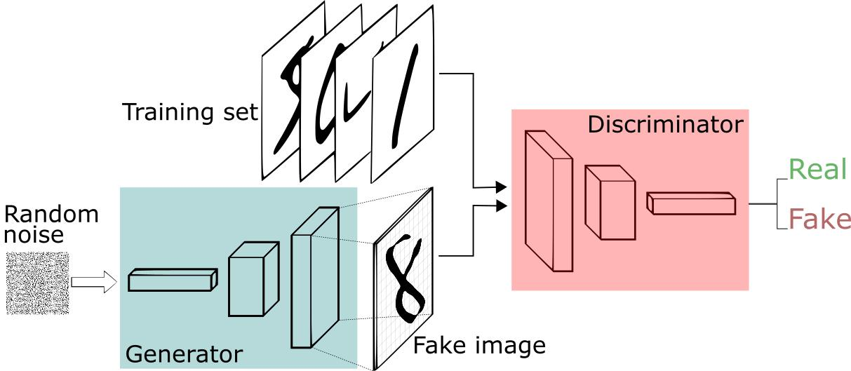
GAN ARCHITECTURE
Architecture of GAN (Image source: Medium: Analytics Vidhya)
Artificial Intelligence & Data Science Seminar: ADQ413 5th October 2023 10/33
Notes:
Random vector or set of values that is fed as input to the GAN's generator network
For creating a realistic image using GAN the noise will be some random numbers which represents a characteristic of the generated image
From training images model has learnt that for bald the value is=0 and for long hair value=1, by selecting random number from 0 to 1 decides amount of hairs. so model can generate persons of different hair length

Slide 12
GAN ARCHITECTURE
Artificial Intelligence & Data Science Seminar: ADQ413 5th October 2023 10/33

Slide 13
GAN ARCHITECTURE
Artificial Intelligence & Data Science Seminar: ADQ413 5th October 2023 10/33

Slide 14
GAN ARCHITECTURE
Artificial Intelligence & Data Science Seminar: ADQ413 5th October 2023 10/33

Slide 15
GAN ARCHITECTURE
Real (1)
Fake (0)
Architecture of GAN (Image source: Medium: Analytics Vidhya)
Artificial Intelligence & Data Science Seminar: ADQ413 5th October 2023 10/33

Slide 16
GANs LOSS FUNCTION
The Standard GAN Loss Function, also known as the Min-Max Loss[1].
The Standard GAN loss function is divided into: Discriminator loss and Generator loss.
Artificial Intelligence & Data Science Seminar: ADQ413 5th October 2023 11/33

Slide 17
GANs LOSS FUNCTION
The Standard GAN Loss Function, also known as the Min-Max Loss[1].
The Standard GAN loss function is divided into: Discriminator loss and Generator loss.
Min-Max Loss Function
E represents the expected value or the average.
x represents real data samples drawn from the real data distribution
D(x) is the output of the Discriminator when it tries to distinguish real data from fake data.
z represents random noise.
G(z) is the output of the Generator when given random noise as input.
1−D(G(z)) represents the probability that the Discriminator assigns to the generated data being fake
(1 minus the probability it assigns to it being real).
Artificial Intelligence & Data Science Seminar: ADQ413 5th October 2023 11/33
Notes:
From this formula, we need to understanding only three terms, minGmaxD, D(x), D(G(z)) Since this equation is little long and tricky, lets derive this equation using an equation we learned the past week, the binary cross entropy equation.

Slide 18
FOR DISCRIMINATOR
We are familiar with the equation of Binary Cross-Entropy:
[ L(x, x’) is the loss. ]
Artificial Intelligence & Data Science Seminar: ADQ413 5th October 2023 12/33
Notes:
This is the general equation for binary cross entropy Lets substitute y=1, for real images and y = 0 for fake images in this equation.

Slide 19
FOR DISCRIMINATOR
We are familiar with the equation of Binary Cross-Entropy:
[ L(x, x’) is the loss. ]
We substitute y = 1 for real images and y = 0 for fake images in the BCE equation, to get:
Artificial Intelligence & Data Science Seminar: ADQ413 5th October 2023 12/33
Notes:
This is the resultant equation, we know that discriminator will try to maximize the loss fn, but here it is min, because we take the negative of the value inside, then minimizing the equation will have the same effect of maximizing the equation. But to make it the std eq. Lets change the -ve sign to +ve sign which will switch the min to max.

Slide 20
FOR DISCRIMINATOR
We are familiar with the equation of Binary Cross-Entropy:
[ L(x, x’) is the loss. ]
We substitute y = 1 for real images and y = 0 for fake images in the BCE equation, to get:
Removing the negative sign will change min to max:
— (1)
Maximizing the loss function means to put D(x) = 1, and D(G(z))) = 0 [Note: log(1) = 0]
So, loss function will result in 0 (Fake image).
Artificial Intelligence & Data Science Seminar: ADQ413 5th October 2023 12/33
Notes:
Consider this equation as eq1

Slide 21
FOR GENERATOR
Generator loss is calculated from the discriminator loss.
Generator will try to fool the discriminator into classifying the fake data as real data. This implies that the generator tries to minimise the second term in the discriminator loss equation.
— (2)
Minimizing the loss function means to put D(G(z))) = close to 1
So, loss function will result in 1 (Real image).
Artificial Intelligence & Data Science Seminar: ADQ413 5th October 2023 13/33
Notes:
Mark this eq as 2, and now we take the sum of both eq 1 and 2, to get our initial GAN min-max equation.

Slide 22
FOR GENERATOR
Generator loss is calculated from the discriminator loss.
Generator will try to fool the discriminator into classifying the fake data as real data. This implies that the generator tries to minimise the second term in the discriminator loss equation.
— (2)
Minimizing the loss function means to put D(G(z))) = close to 1
So, loss function will result in 1 (Real image).
By summing both the equations (1) & (2), we get:
Min-Max Loss Function
Artificial Intelligence & Data Science Seminar: ADQ413 5th October 2023 13/33
Notes:
Draw → min-max game as the last thing on the figure…

Slide 23
GAN TRAINING
Start GAN training in alternating periods.
The discriminator trains for one or more epochs then the generator’s turn and this step repeats.
Careful training is required, as most challenges of GANs are in training phase.
Optimal training duration will depend on:
Complexity of the data being generated
Size of the training dataset, and
Desired quality of the generated data.
Stopping the training:
Generator is able to produce high-quality samples that are identical to real data.
Discriminator is no longer able to classify real and fake data with high accuracy.
Artificial Intelligence & Data Science Seminar: ADQ413 5th October 2023 14/33

Slide 24
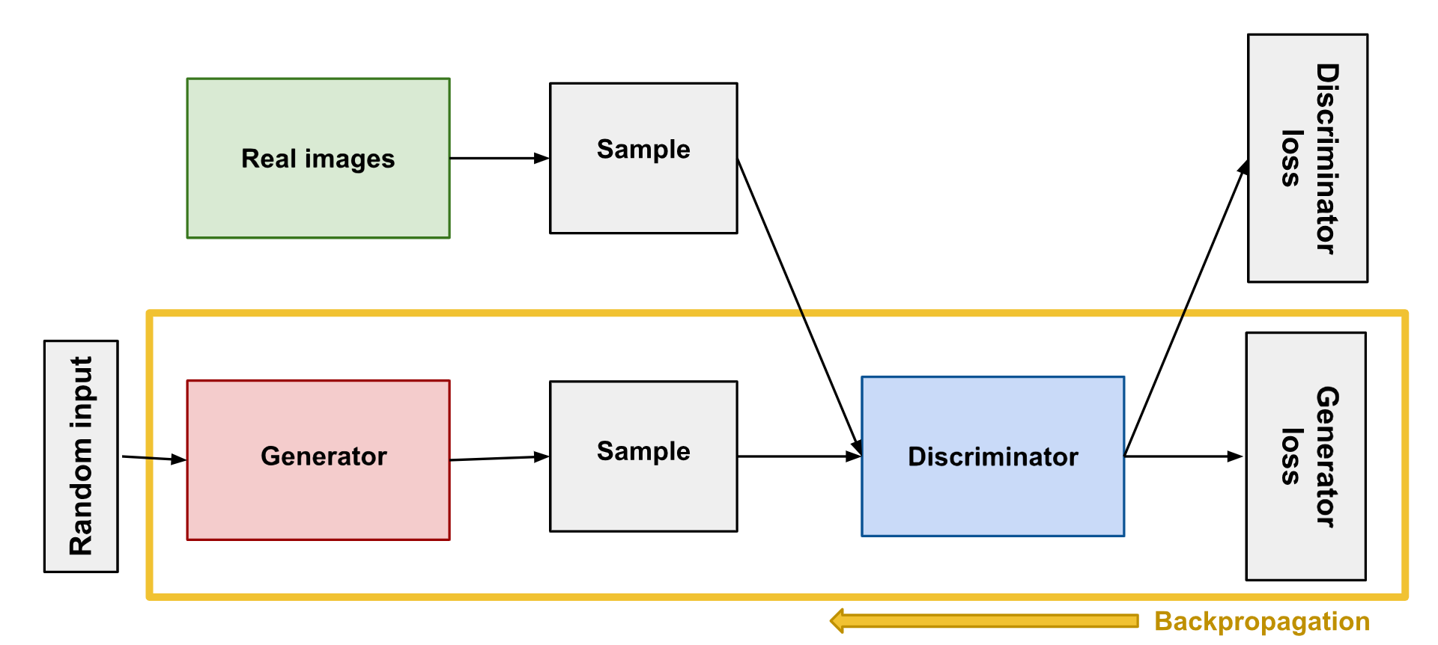
GENERATOR TRAINING
The discriminator is kept constant during the generator training phase. Else the generator would try to hit a target (output of discriminator) and never converge.
Random noise → Generator output → Discriminator classification → Loss calculation from discriminator classification → Backpropagates through both the discriminator and generator to obtain gradients → Use gradients to change only the generator weights.
(constant)
Backpropagation in generator training. (Image source: Google Developers)
Artificial Intelligence & Data Science Seminar: ADQ413 5th October 2023 15/33
Notes:
During the training of the generator, the discriminator is frozen.

Slide 25
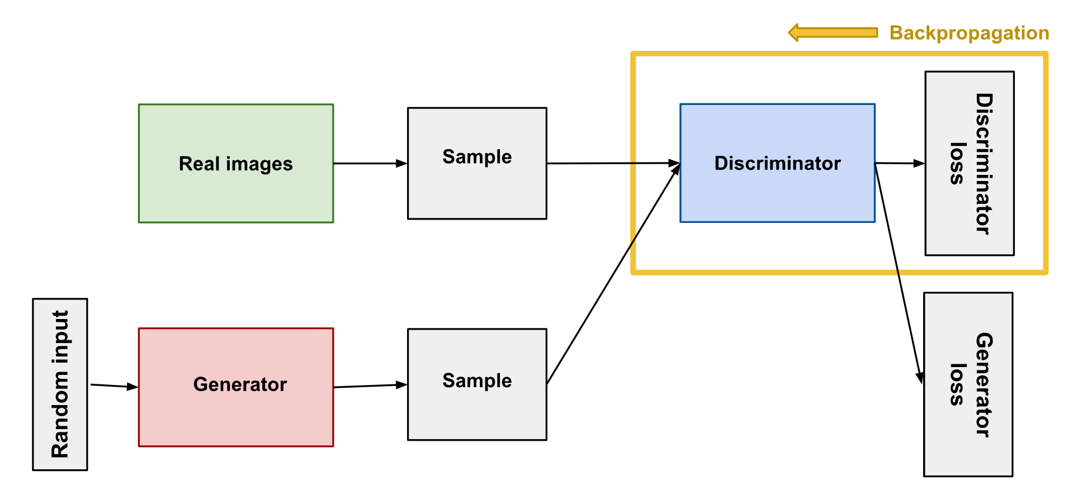
DISCRIMINATOR TRAINING
During discriminator training the generator is paused. Its weights remain constant while it produces examples for the discriminator to train on.
Fake Image → Discriminator classification → Loss calculation → Backpropagation → Use gradients to change discriminator weights.
(constant)
Backpropagation in discriminator training. (Image source: Google Developers)
Artificial Intelligence & Data Science Seminar: ADQ413 5th October 2023 16/33

Slide 26
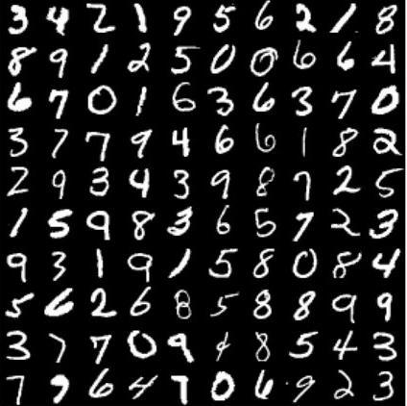
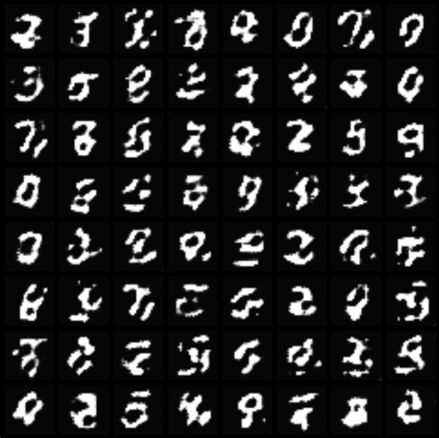
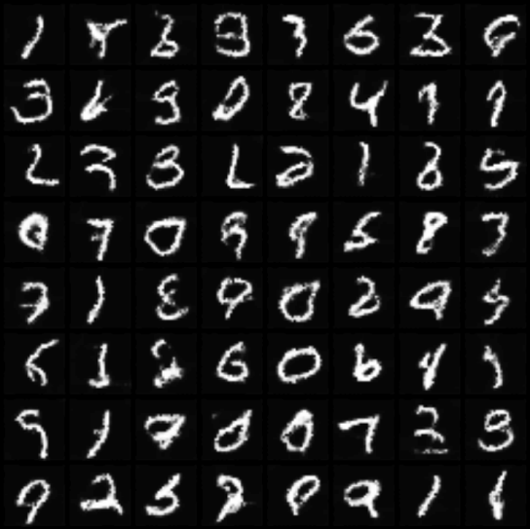
GAN WORKING ON MNIST DATASET
Ground Truth Epoch 10 Epoch 100
Progress during training the GAN (Image source: Neptune AI)
Artificial Intelligence & Data Science Seminar: ADQ413 5th October 2023 17/33
Notes:
Now we understood, gan is a promising and powerful technology but still it has its own challenges…

Slide 27
GAN CHALLENGES
→ Mode Collapse
Issue: GAN fails to capture and generate diverse samples from the entire data distribution. Instead, it may focus on generating samples from only a few modes or patterns in the data. This results in a lack of diversity in the generated outputs.
Why it's a challenge: It makes the generated data less useful for tasks like data augmentation or creative content generation.
→ Non-Convergence
Issue: The discriminator performance gets worse when generator outperforms it, thus lowering the accuracy of discriminator.
Why it's a challenge: The discriminator feedback gets less meaningful over time and gives random feedback to generator, by which the generator starts to train on junk feedback, reducing its own quality.
Artificial Intelligence & Data Science Seminar: ADQ413 5th October 2023 18/33
Notes:
mode collapse: The generator over-optimizes for a specific discriminator with each iteration, and the discriminator never learns how to get out of the trap.

Slide 28
TYPES OF GANs
A normal GAN may be unstable with different challenges like Mode Collapse, Non-Convergence, Uninformative Loss, and Sensitive Hyperparameter. To solve these problem to an extend, new types of GANs like DCGAN [3], SAGAN [5], VAE-GAN [6], TransGAN [7] and 500+ other GANs were introduced.
Conditional GAN (CGAN)
Generative adversarial nets can be extended to a conditional model if both the generator and discriminator are conditioned on some extra information y.
– Conditional Generative Adversarial Nets Paper [10]
New y term is introduced.
Adding y term gives more control over the output.
Artificial Intelligence & Data Science Seminar: ADQ413 5th October 2023 19/33
Notes:
A normal gan or vanilla gan will create random images that are present in the training data, but with CGAN we will get more control over the output, for example if we are working with the mnist data, then if we give y=3, then the generator will only generate the number 3.

Slide 29
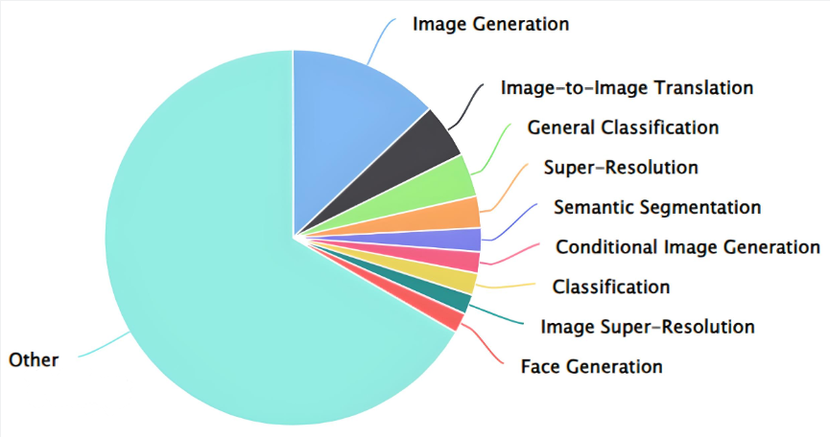
USE CASES OF GANs
Source: Papers with code
Artificial Intelligence & Data Science Seminar: ADQ413 5th October 2023 20/33

Slide 30
GAN RECENT APPLICATION
Visualizing CNN’s Learned Features using FIGAN
Research Paper Title: Feature Interpretation Using Generative Adversarial Networks (FIGAN): A Framework for Visualizing a CNN’s Learned Features (January 2023).
The brief of the paper:
Discusses the limitations of current methods for explainability in medical imaging classification tasks.
Proposed FIGAN framework that uses a Conditional Generative Adversarial Network(CGAN) for visualizing CNN learned features.
How FIGAN differs from other methods in its approach to visualizing a CNN's learned features.
Provides an example of how FIGAN has been used in a real-world medical imaging application.
Artificial Intelligence & Data Science Seminar: ADQ413 5th October 2023 21/33
Notes:
Most images related works mostly use CNN layers for the architecture, and they will get complex when we need obtain deep features of an image. So with this work the researchers are trying to explore the learned feature or the feature maps of CNN thereby getting a deep understanding of how CNNs takes decisions.

Slide 31
Problem that the research paper addresses:
Limited explainability in medical imaging classification tasks using CNN.
Lack of transparency limits the translation of these methods into clinical radiology practice.
Most CNN’s architectural complexity makes it difficult to explain the imaging features.
Artificial Intelligence & Data Science Seminar: ADQ413 5th October 2023 22/33

Slide 32
How GANs are used to solve the problem:
Researchers used FIGAN Framework(Type of GAN) that uses CGAN to create images representing CNN's key features.
Solution involves a two-stage training process:
First: train a CNN on the medical imaging dataset to be analyzed.
Second: train the FIGAN model to generate images of main features from CNN
The authors also perform a series of experiments to study the effect of auxiliary segmentations, training sample size, and image resolution on FIGAN's ability to provide consistent and interpretable synthetic images.
Artificial Intelligence & Data Science Seminar: ADQ413 5th October 2023 23/33

Slide 33
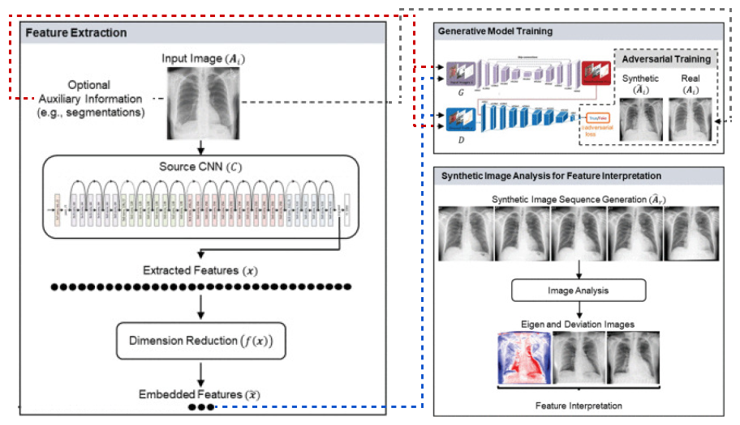
ARCHITECTURE
Three main steps:
Feature Extraction (CNN),
Generative Model Training (FIGAN), and
Generated Image Analysis (to gain insights into the CNN's decision-making process and identify which features are most important for classification).
Image Source: [9]
Artificial Intelligence & Data Science Seminar: ADQ413 5th October 2023 24/33
Notes:
We start with an input image, and this image is given to a pre-trained CNN

Slide 34
ARCHITECTURE
Three main steps:
Feature Extraction (CNN),
Generative Model Training (FIGAN), and
Generated Image Analysis (to gain insights into the CNN's decision-making process and identify which features are most important for classification).
Image Source: [9]
Artificial Intelligence & Data Science Seminar: ADQ413 5th October 2023 24/33
Notes:
the CNN extracts thousands of features from the input image, these features can be extracted from any intermediate layer within the CNN, but the researchers focussed only
on the high level features from the final fully-connected layer, which are more likely to explain a CNN’s decisions.

Slide 35
ARCHITECTURE
Three main steps:
Feature Extraction (CNN),
Generative Model Training (FIGAN), and
Generated Image Analysis (to gain insights into the CNN's decision-making process and identify which features are most important for classification).
Image Source: [9]
Artificial Intelligence & Data Science Seminar: ADQ413 5th October 2023 24/33
Notes:
As the number of features are more in count, the unwanted features are reduced or deleted using a dimensionality reduction method just like PCA, but here they have used a method called Partial Least Squares (PLS).
PCA: PCA is an unsupervised technique primarily used for reducing the dimensionality of data while preserving as much variance as possible. It doesn't consider any specific outcome or target variable.
PLS: PLS is a supervised technique used for dimensionality reduction in the context of regression and predictive modeling. It focuses on finding the directions in the feature space that are most related to the target variable.

Slide 36
ARCHITECTURE
Three main steps:
Feature Extraction (CNN),
Generative Model Training (FIGAN), and
Generated Image Analysis (to gain insights into the CNN's decision-making process and identify which features are most important for classification).
Image Source: [9]
Artificial Intelligence & Data Science Seminar: ADQ413 5th October 2023 24/33
Notes:
The selected features are then given to CGAN’s Generator and Discriminator for training the GAN to make realistic images.

Slide 37
ARCHITECTURE
Three main steps:
Feature Extraction (CNN),
Generative Model Training (FIGAN), and
Generated Image Analysis (to gain insights into the CNN's decision-making process and identify which features are most important for classification).
Image Source: [9]
Artificial Intelligence & Data Science Seminar: ADQ413 5th October 2023 24/33
Notes:
Now the images made by the CGAN or the synthetic images have most features which actually contributes to CNN decision making process, these images are then analysed, and can be viewed as a gif or under a medical image viewing device. To understand whether the CNN has taken most relevant features into consideration or not.

Slide 38
Results of the research paper:
Proposed FIGAN framework provides a new level of understanding and explainability in medical imaging classification tasks.
Using FIGAN on previously developed CNNs (Gradient-Based Saliency Maps, Attention Networks) show that the resulting feature interpretations can clarify ambiguities within attention areas highlighted.
The authors also demonstrate that FIGAN can provide consistent and interpretable synthetic images across a range of medical imaging datasets.
Artificial Intelligence & Data Science Seminar: ADQ413 5th October 2023 25/33

Slide 39
Limitations of the research paper:
Proposed FIGAN framework requires a pre-trained CNN, which may not always be available or may not be applicable to all medical imaging classification tasks.
Synthetic images generated by FIGAN may not always be clinically relevant or useful for diagnosis.
Further experiments by authors show that FIGAN's ability is affected by auxiliary segmentations, training sample size, and image resolution.
Additionally, the authors notes the interpretability of CNNs as a complex and ongoing research area.
FIGAN is just one approach to improving the explainability of CNNs in medical imaging classification tasks.
Artificial Intelligence & Data Science Seminar: ADQ413 5th October 2023 26/33
Notes:
Not clinically relevant images → edges of cross-sectional images of a kidney may not be relevant when we search for something that lie inside the kidney.
Now we have came to the last part of our learning path, i believe you remember our story of that young and talented photographer,
He has leveraged the power of GANs in his images and he got the results as….this..
……….SAY STORY END HERE……….

Slide 40
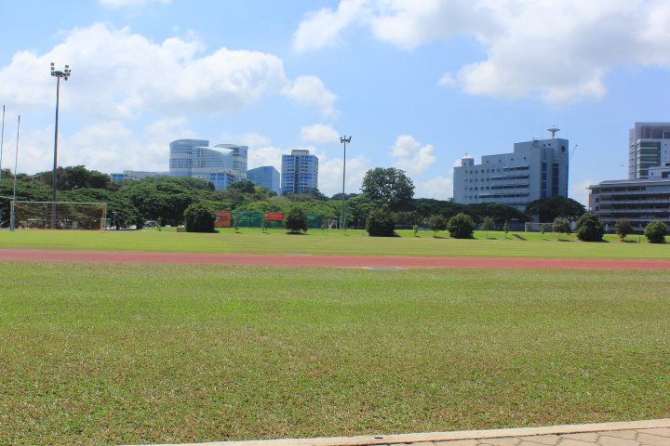
THE STORY ENDING
Young Photographer got this result after using GAN for his problem
BEFORE AFTER
Artificial Intelligence & Data Science Seminar: ADQ413 5th October 2023 27/33

Slide 41
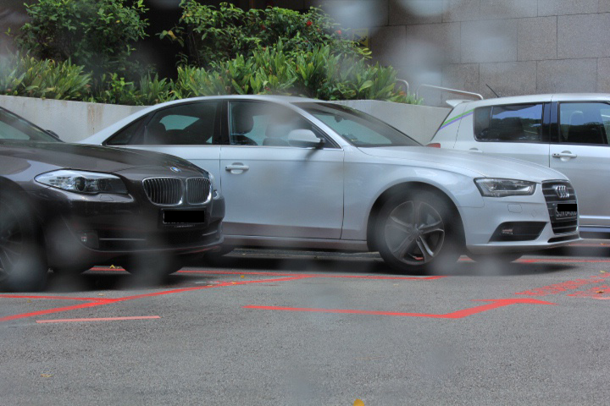
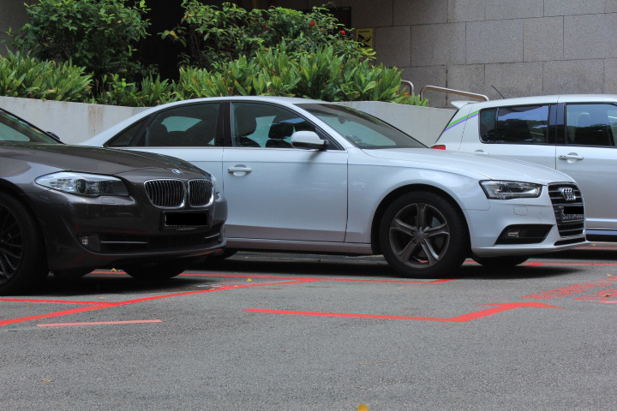
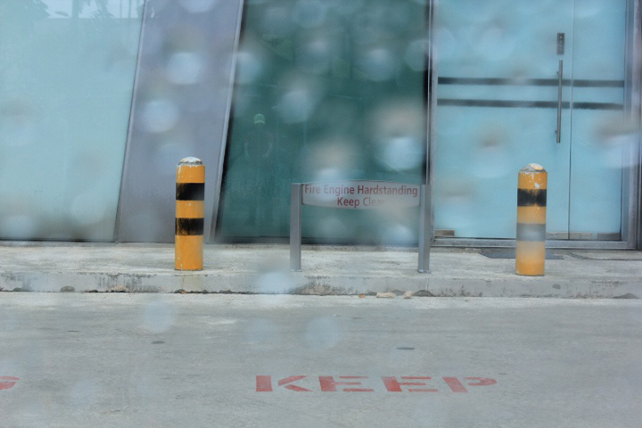
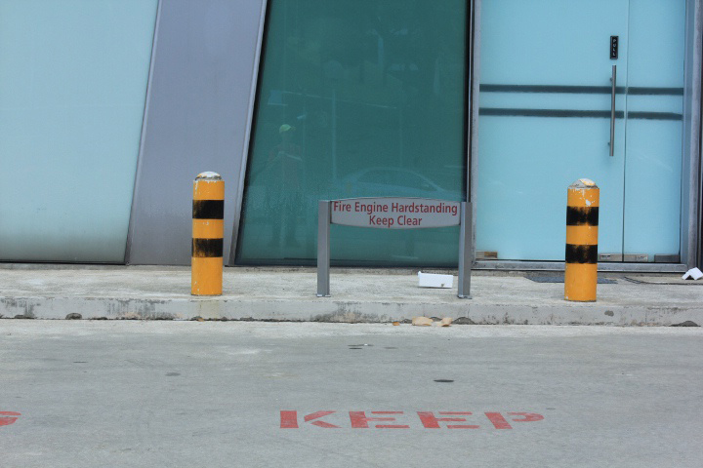
BEFORE AFTER (Source: [8] See this)
Artificial Intelligence & Data Science Seminar: ADQ413 5th October 2023 28/33
Notes:
Some more images…
Now we have came to the conclusion of the seminar, if you are thrilled to do some coding, you can always browse GITHUB to find useful codes, and if you dont want to code but need to use the power of GANs, then consider these apps…

Slide 42
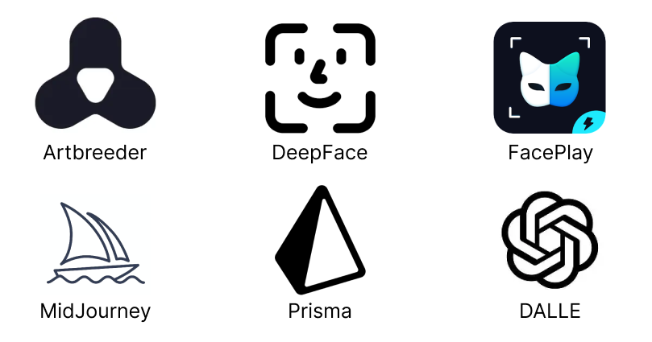
From a simple idea, GANs has created a storm.
Backend of these apps are powered by various architectures of GANs.
Artificial Intelligence & Data Science Seminar: ADQ413 5th October 2023 29/33
Notes:
So thats all about my seminar

Slide 43
References
[1] Ian Goodfellow, “NIPS 2016 Tutorial: Generative Adversarial Networks”, DOI: arXiv.1701.00160, Dec 2016.
[2] Ian J. Goodfellow, Jean Pouget Abadie, Mehdi Mirza, Bing Xu, David Warde Farley, Sherjil Ozair, Aaron Courville,Yoshua Bengio, “Generative Adversarial Nets”, DOI: arXiv:1406.2661, June 2014.
[3] Zhaoqing Pan, Weijie Yu, Xiaokai Yi, Asifullah Khan, Feng Yuan, Yuhui Zheng, “Recent Progress on Generative Adversarial Networks (GANs): A Survey”, DOI: 10.1109/ACCESS.2019.2905015, March 2019.
[4] Radford, Alec, Metz, Luke, Soumith Chintala, "Unsupervised Representation Learning with Deep Convolutional Generative Adversarial Networks", DOI: ICLR.S2CID 11758569, November 2015
[5] Han Zhang, Ian Goodfellow, Dimitris Metaxas, Augustus Odena, "Self-Attention Generative Adversarial Networks", DOI: PMLR: 7354–7363, June 2019.
Artificial Intelligence & Data Science Seminar: ADQ413 5th October 2023 30/33
Notes:
Don’t go into the details of these too much
You are welcome to brief a little about [5]

Slide 44
[6] Anders Boesen Lindbo Larsen, Søren Kaae Sønderby, Hugo Larochelle, Ole Winther, "Autoencoding beyond pixels using a learned similarity metric". DOI: arXiv:1512.09300, February 2016.
[7] Yifan Jiang, Shiyu Chang, Zhangyang Wang, "TransGAN: Two Pure Transformers Can Make One Strong GAN, and That Can Scale Up", DOI: arXiv:2102.07074, December 2021.
[8] Egor Zakharov, Aliaksandra Shysheya, Egor Burkov, Victor Lempitsky, “Few-Shot Adversarial Learning of Realistic Neural Talking Head Models”, DOI: arXiv:1905.08233, May 2019.
[9] Kyle A. Hasenstab, Justin Huynh, Samira Masoudi, Guilherme M. Cunha, Michael Pazzani, Albert Hsiao, “Feature Interpretation Using Generative Adversarial Networks (FIGAN): A Framework for Visualizing a CNN’s Learned Features”, DOI: 10.1109/ACCESS.2023.3236575, January 2023.
[10] Mehdi Mirza, Simon Osindero, “Conditional Generative Adversarial Nets (CGAN)”, DOI: arXiv:1411.1784v1, November 2014.
For more resources related to GANs, see here
Artificial Intelligence & Data Science Seminar: ADQ413 5th October 2023 31/33
Notes:
You can find more resources related to gans in the link given below.

Slide 45
Thank You
Artificial Intelligence & Data Science Seminar: ADQ413 5th October 2023 33/33

Slide 46
Questions?
Artificial Intelligence & Data Science Seminar: ADQ413 5th October 2023 32/33
Notes:
Frame questions that can be expected and put them on another slide, to prepare us to face any type of queries.
Don’t stutter or remain silent, make sure to continue the flow.

